Slide 1

US Accidents Data Analysis
Rochana Dudwadkar
Akhila Konda

Slide 2
OBJECTIVES
Analysis of major accident-prone States and Counties
Prediction of safer travel hours during the week
Weather analysis of accidents

Slide 3
DATA DESCRIPTION
# | Attribute | Description
1 | ID | This is a unique identifier of the accident record.
2 | Severity | Shows the severity of the accident, a number between 1 and 4, where 1 indicates the least impact on traffic (i.e., short delay as a result of the accident) and 4 indicates a significant impact on traffic (i.e., long delay).
3 | Start Time/ End Time | Shows start time and end time of the accident in local time zone.
4 | Weather Condition | Shows the weather condition (rain, snow, thunderstorm, fog, etc.)
5 | Distance(mi) | The length of the road extent affected by the accident.
6 | Side | Shows the relative side of the street (Right/Left) in address field.
7 | Location (Country, State, City, County, Zip code) | Shows the country, state, city, county and zip code in address field.
8 | Visibility | Shows the visibility in miles.
9 | Traffic signal, Junction, Crossing, Station, Stop | Shows presence of a traffic signal, junction, crossing, station or stop in a nearby location.
10 | Sunrise/ Sunset | Shows the period of day (i.e. day or night) based on sunrise/sunset.
11 | Duration | Shows duration of the accident

Slide 4
DATA PREPROCESSING STEPS
Eliminated unwanted variables
Removed null values
Calculated Duration of accident using Start and End dates
Pivoted columns to interpret data

Slide 5
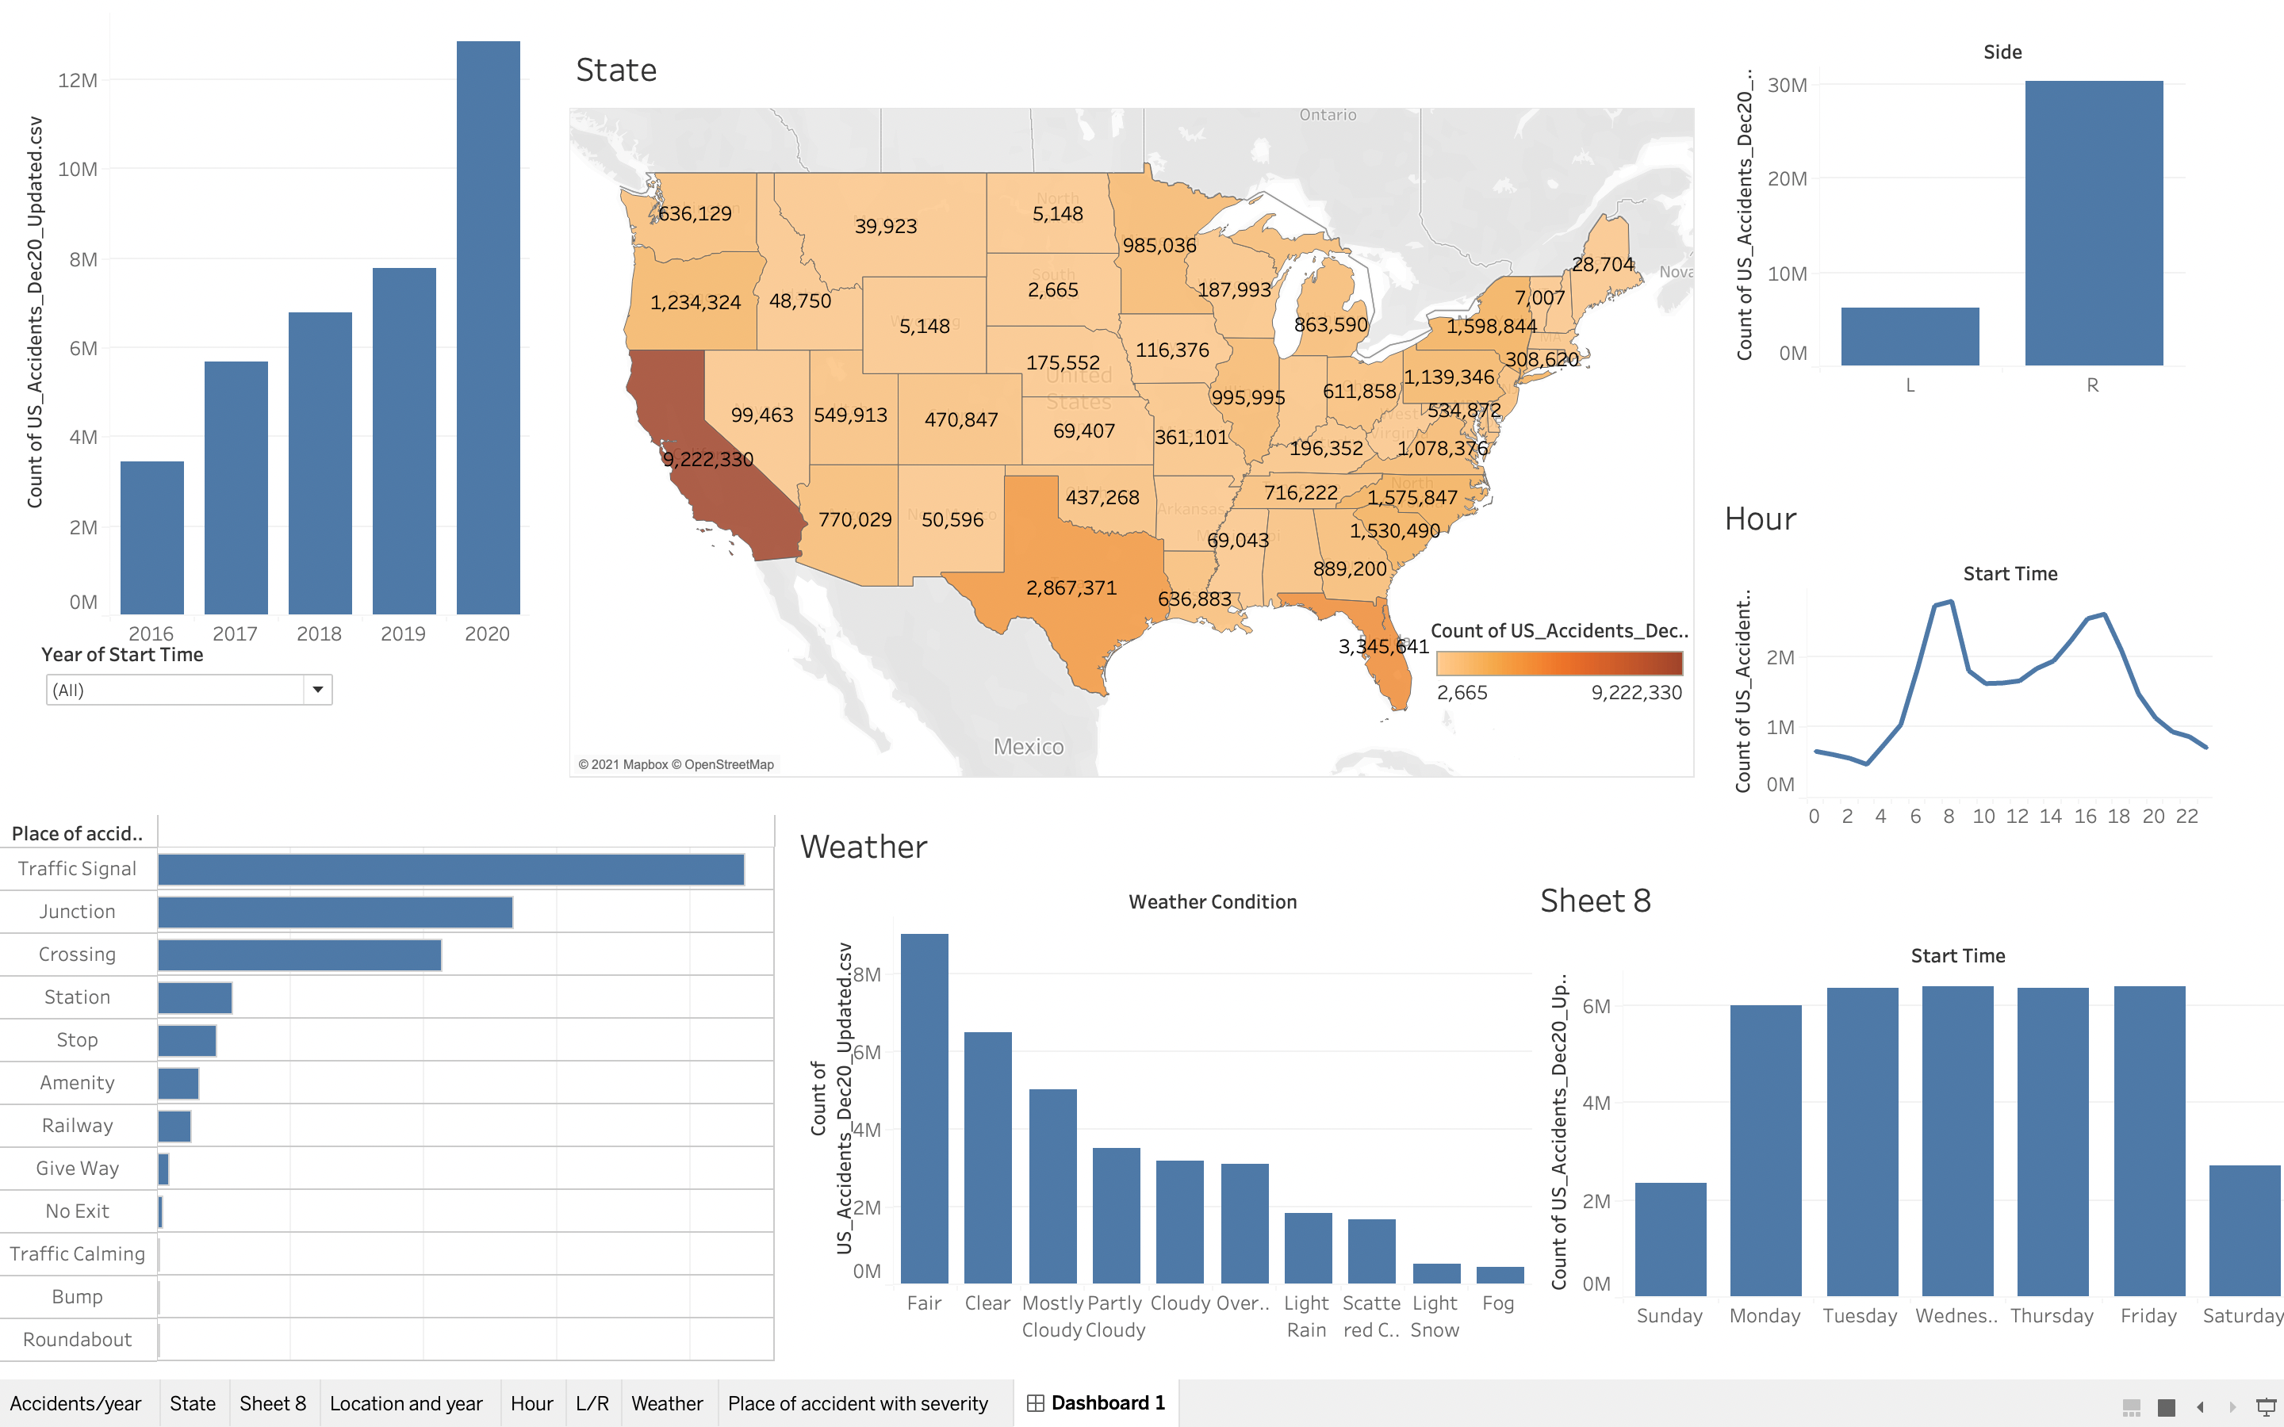
INITIAL ANALYSIS

Slide 6
CHALLENGES FACED
High Time in processing of data due to its volume
Missing data in different variables
Difficulty in finding additional datasets for population

Slide 7
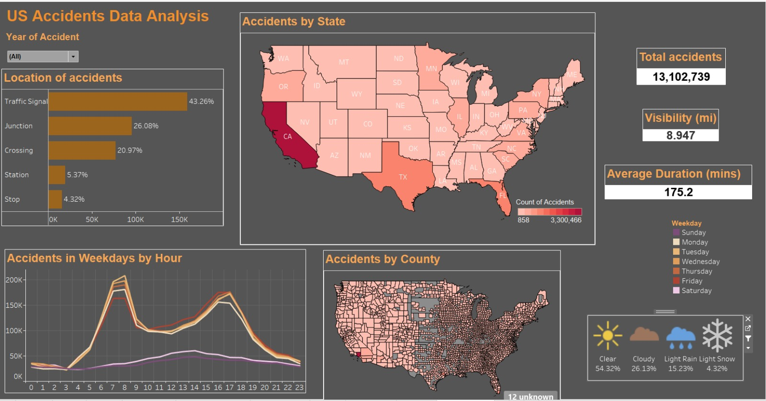
DASHBOARD

